Slide 1
Capstone Project
Java Selenium Batch - 4
Name : Kotha Meghana
Superset ID : 4748248

Slide 2
Nop-commerce Automation

Slide 3
Contents
Contents | 3
Project Structure | 4
Automation frame work and tools | 5
Feature files | 6
Feature file Runner class src/main/java | 7 8 9
src/test/java | 10
Screenshot reports | 11
Extent report | 12
OutPut Reports | 13
Cuccumber report Console and result of running suite End | 14 15 16

Slide 4
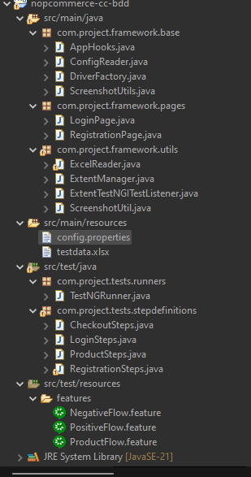
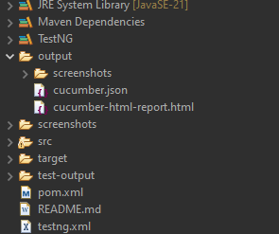
Project Structure:

Slide 5
Automation Framework & Tools
Core Automation: Selenium with Java
Build & Dependency Management: Maven Build Tool
Behavior-Driven Development (BDD): Cucumber, using Gherkin syntax for feature files
Design Pattern: Page Object Model (POM) for creating reusable and maintainable classes
Test Runner: TestNG for suite execution, parallel testing, and multi-browser support
Data Handling: Data-Driven Testing using Excel (Apache POI) and Cucumber Examples/Tables
Utilities: Reusable utilities for managing drivers, waits, elements, and property files
🔗meghana1373/Capstone_Credit_Card_Automation

Slide 6
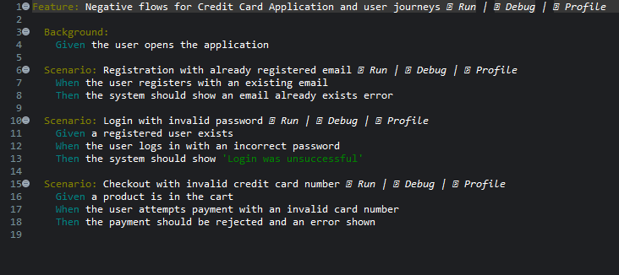
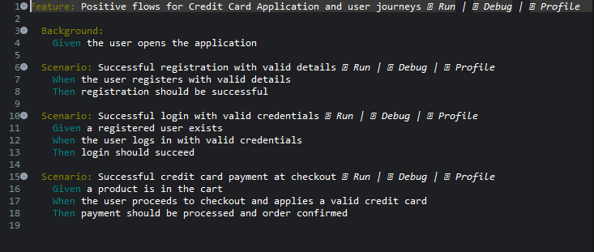
Feature Files:
Positive Testcase: Registration → Login
Negative Testcase: Invalid Login→ email already exists→
Product adding to cart:product will add to cart

Slide 7
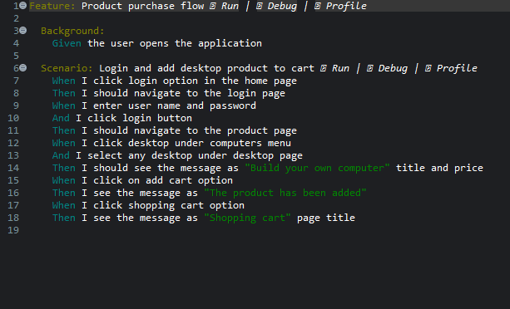
Feature file:

Slide 8

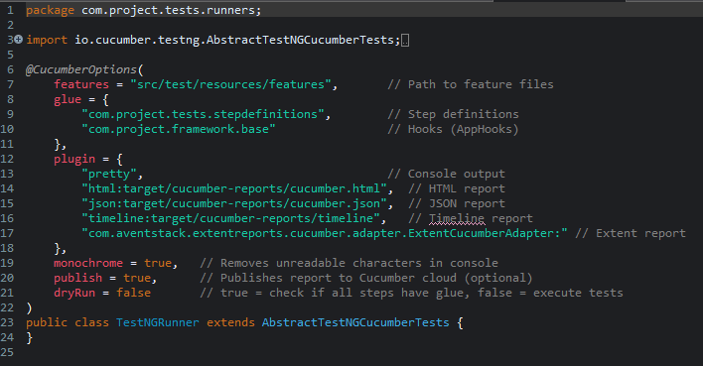
Runner class
ADD COMPANY NAME
The runner class executes all feature files, integrates Cucumber with TestNG, and generates automation reports.
TestRunner.java -
The TestRunner.java class integrates Cucumber with TestNG to execute all feature files in the project.
It specifies feature file locations, step definitions, and generates HTML and JSON reports for automation results

Slide 9
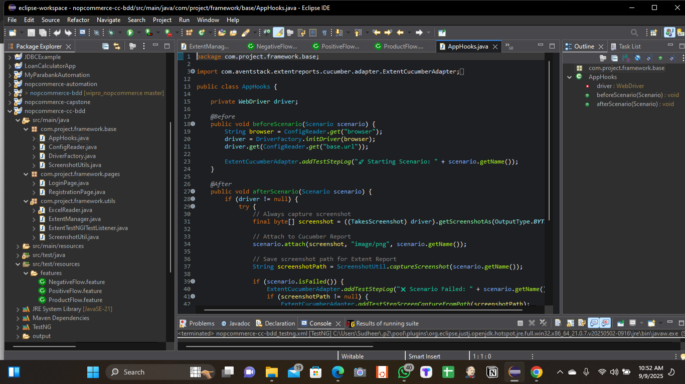
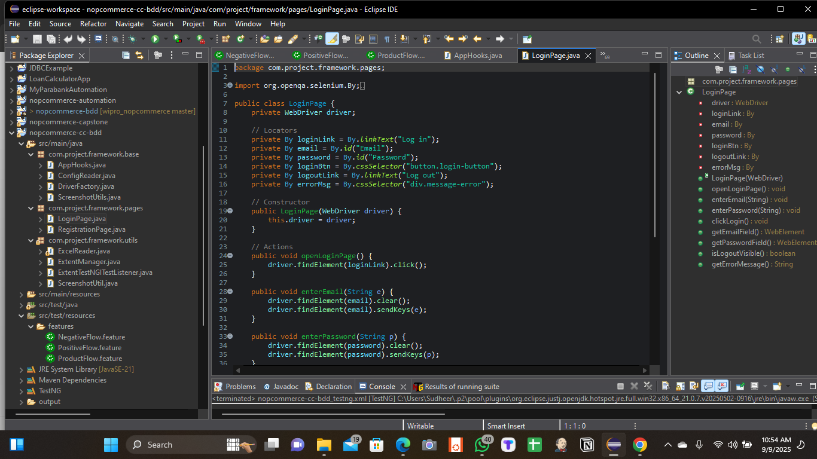
src/main/java:

Slide 10
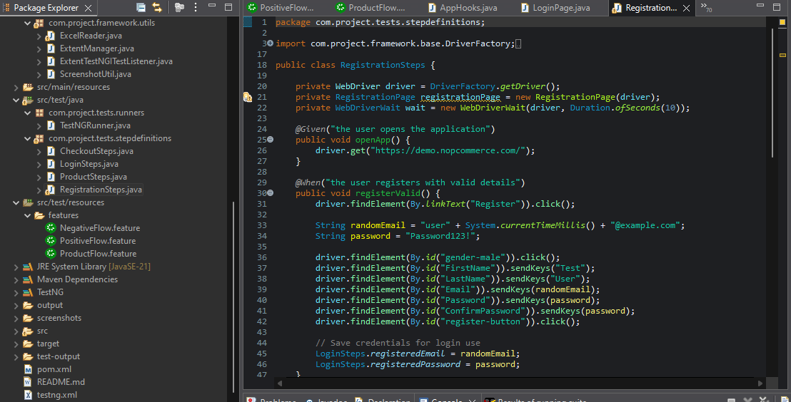
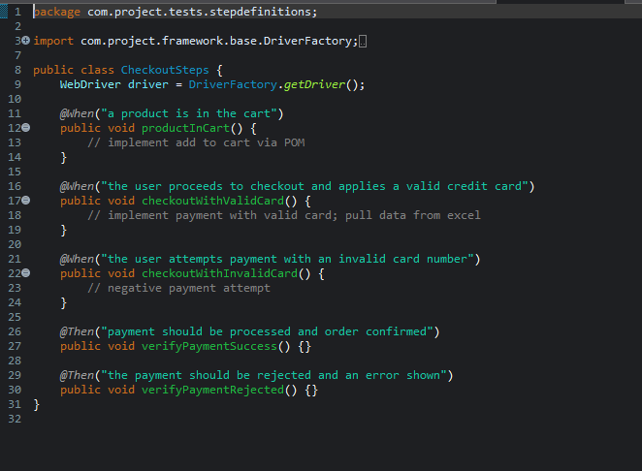
Src/Test/Java:

Slide 11
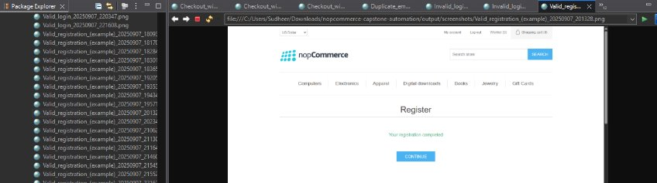
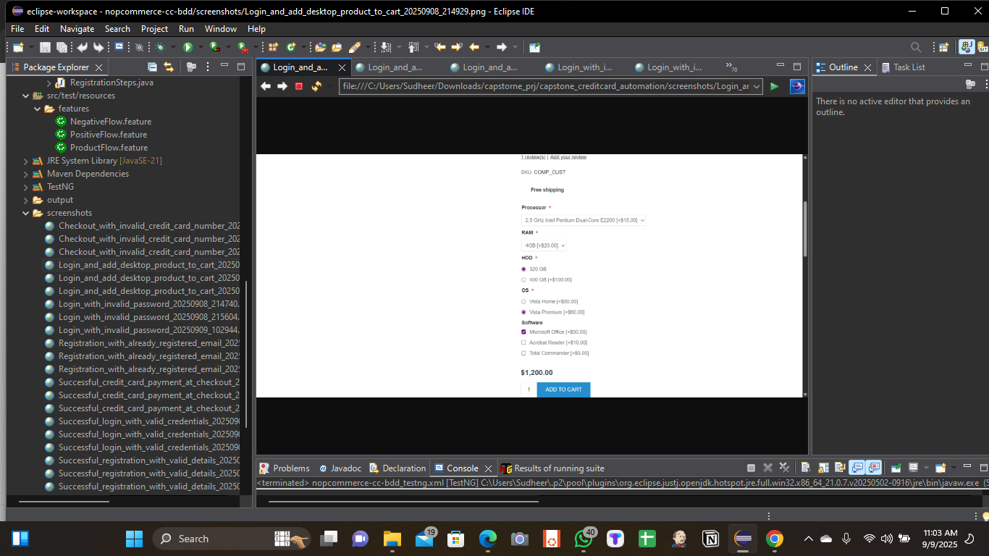
Screenshot Reports:
ExtentReportManager.java
Manages the creation and configuration of Extent Reports for test execution.
Creates timestamped HTML reports to ensure each test run has a unique report file.
Provides methods to create and retrieve individual test logs and flush reports to disk after execution.

Slide 12
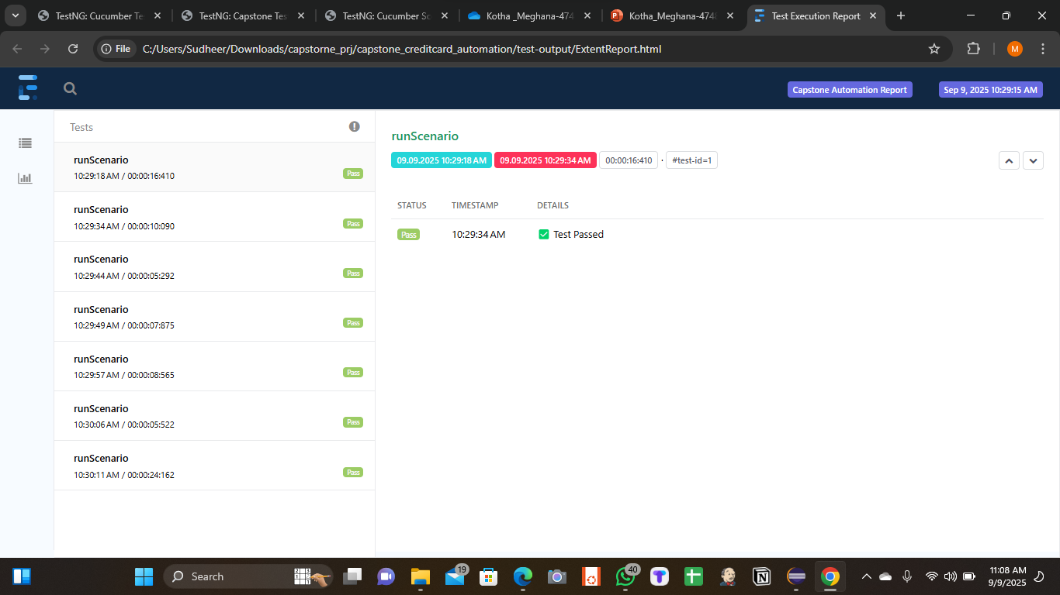
Extent Report:

Slide 13
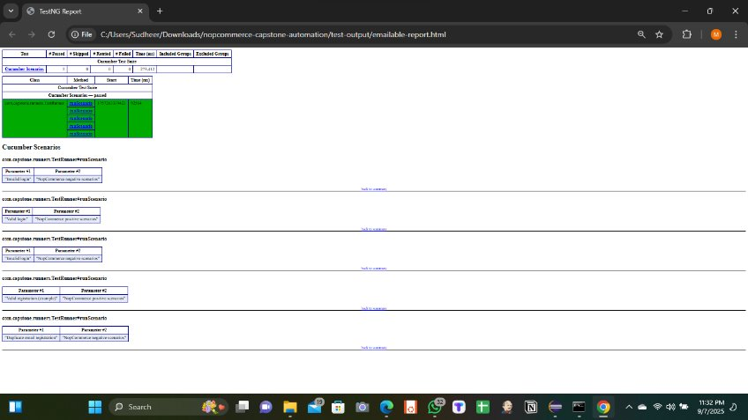
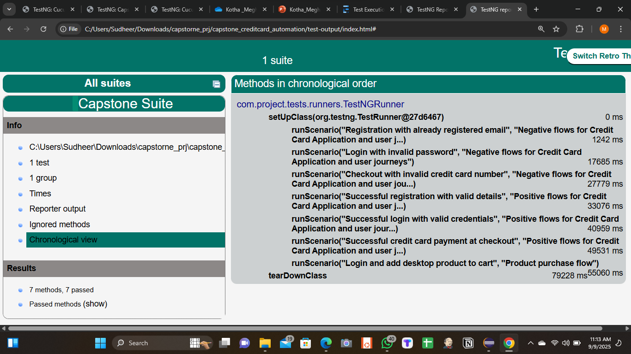
OutPut Reports :
Emailable-report.html Index.html

Slide 14
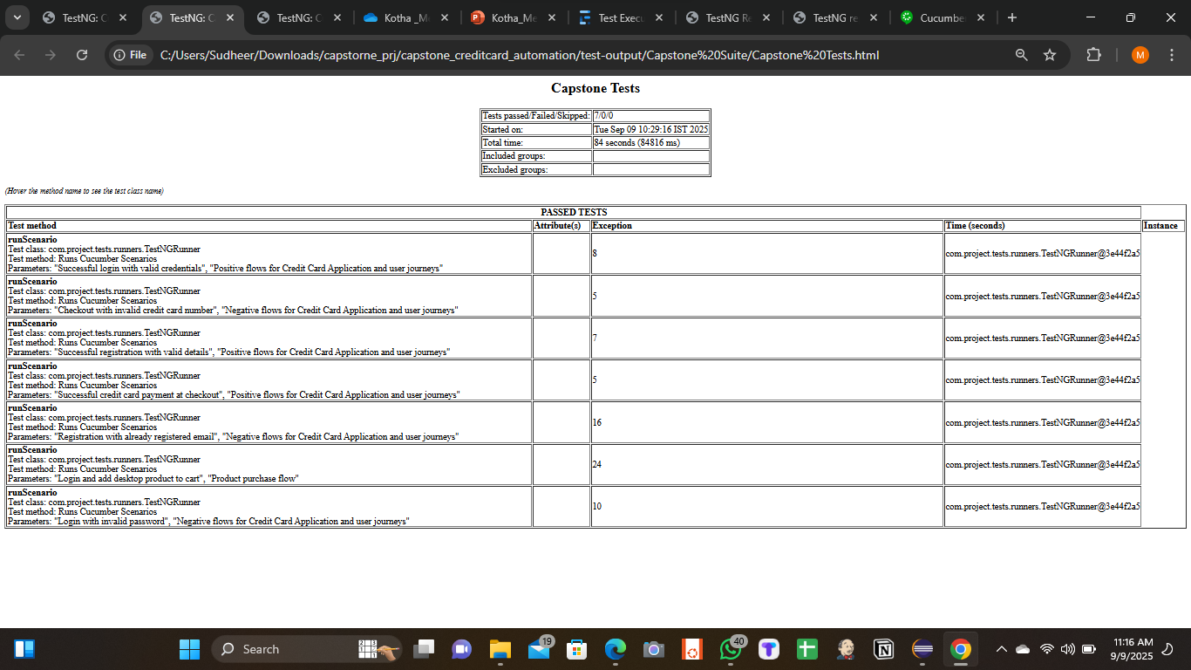
Cucumber Reports :

Slide 15
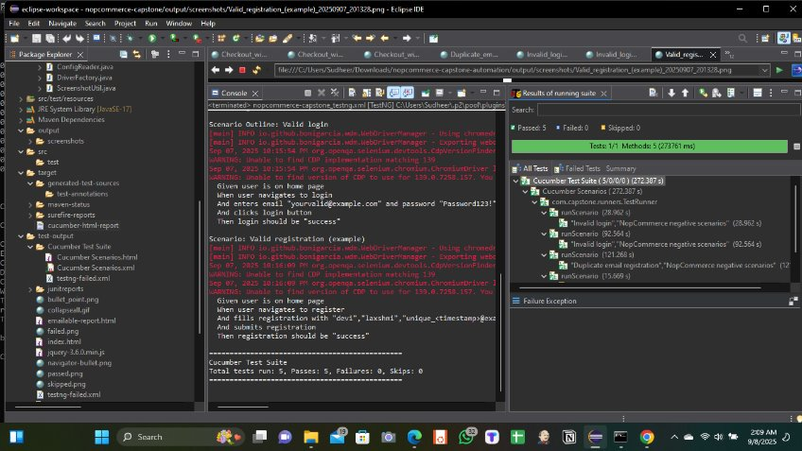
Console and Results of running suite:

Slide 16
THANK YOU

